Slide 1
Choosing where to live in an era of remote employment
Coursera Capstone: Battle of the Neighborhoods

Slide 2
Introduction
The COVID-19 pandemic normalized remote employment and made it possible for many workers to live almost anywhere without having to separate from their current employer. This project uses structured, agglomerative clustering to compare neighborhoods in two cities, Toronto and Philadelphia, using data from Foursquare. Neighborhoods from each city are associated with similar neighborhoods in the other city. Neighborhoods that are relatively dissimilar from neighborhoods in the other city are also identified. By characterizing the neighborhoods of each city relative to the other, someone familiar with only one city's neighborhoods (e.g., a current resident) could make a better decision about where in the other city to live. Though this project is limited to just two cities, the scope could be broadened to an arbitrary number of locales. Results are summarized geospatially and a brief qualitative review of Foursquare data by groups of neighborhoods is discussed.

Slide 3
Data
Toronto and Philadelphia have 103 and 48 postal codes, respectively. These postal codes serve as proxies for each city's neighborhoods.
Github user AG2816 posted a geoJSON file containing Toronto's postal codes, available here: https://github.com/ag2816/Visualizations/raw/master/data/Toronto2.geojson
The organization OpenDataPhilly.org (https://opendataphilly.org) provides geoJSON files for Philadelphia postal codes, available here: http://data.phl.opendata.arcgis.com/datasets/b54ec5210cee41c3a884c9086f7af1be_0.geojson
I replaced the postal codes associated with neighborhood names are available in the Jupyter notebook associated with this report.
For Toronto, I scraped neighborhood names from this Wikipedia page: https://en.wikipedia.org/wiki/List_of_postal_codes_of_Canada:_M) Wikipedia
For Philadelphia, I compiled neighborhood names from pages 18 and 19 of this Pew Charitable Trusts report: https://www.pewtrusts.org/en/research-and-analysis/reports/2014/07/09/homeownership-in-philadelphia-on-the-decline.
To compare neighborhoods in the two cities, I used data from Foursquare. I did not consider additional neighborhood data (e.g., housing prices, crime, access to public transportation, etc.), though it would be possible to expand the analysis to include an arbitrary number of features.
Copies of all data used in this analysis are available here: https://github.com/JaeAre/Coursera_Capstone.git, including the results retrieved from Foursquare.

Slide 4
Methodology
Structured Agglomerative Clustering Approach
If the neighborhoods of Philadelphia all cluster together, and the neighborhoods of Toronto all cluster together, this analysis would not be useful for someone familiar with one city trying to learn about the other.
Structure imposed by a connectivity matrix to ensures mixing of neighborhoods across Toronto and Philadelphia.
Algorithm Details
AgglomerativeClustering algorithm in scikit-learn.
The metric used to compute the linkage is Euclidean and a ward criterion is used to minimize the variance of the clusters being merged.
Number of clusters decided using a two-step approach
First, determine the optimal number of clusters using the silhouette score (see, for example, https://en.wikipedia.org/wiki/Silhouette_(clustering)). Set this as the upper limit on the number of clusters.
Next, examine the dendrogram. If a relatively small reduction in the number of clusters leads to a relatively large reduction in complexity, reduce the number of clusters accordingly.

Slide 5
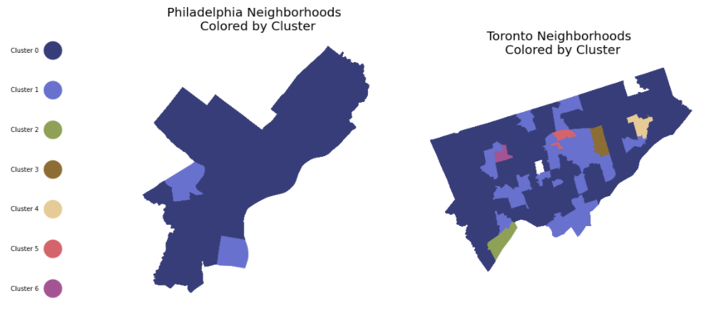
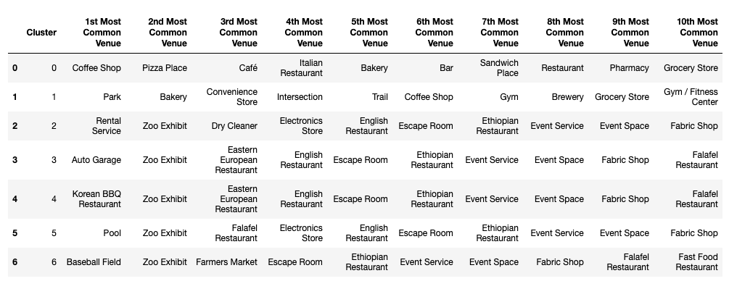
Results

Slide 6
Results (continued)
The first cluster (cluster 0) contains 64 Toronto neighborhoods and 44 Philadelphia neighborhoods. This is by far the largest cluster in terms of number of neighborhoods it contains. Looking across its top ten venues, this cluster seems like an ideal residential cluster, with restaurants, bars and cafes, as well as a grocery store and pharmacy.
The second cluster (cluster 1) contains 23 Toronto neighborhoods and 2 Philadelphia neighborhoods. It seems like it might be a little less residential with fewer options neighborhood activities. However, parks and gyms figure more prominently in this cluster, suggesting it might be a better choice for someone who prefers more active recreational activities.
The remaining five clusters contain a single Toronto neighborhood each. These clusters all share a zoo exhibit and event space. From the Foursquare data, these Toronto neighborhoods do not look very residential.

Slide 7
Discussion
The purpose of this project was to cluster the neighborhoods of two cities, Toronto and Philadelphia, so that someone familiar with one city could better understand the neighborhoods in the other city.
Some additional avenues of exploration might be:
Expand the analysis to beyond two cities so that someone familiar with one city could choose one among many city's neighborhoods for relocation.
Incorporate data beyond those available from Foursquare (i.e., housing prices, crime, etc.)
Adjust the structure of the analysis (i.e., the connectivity matrix) so that results could be tailored to the reference city of the user.

